Slide 1
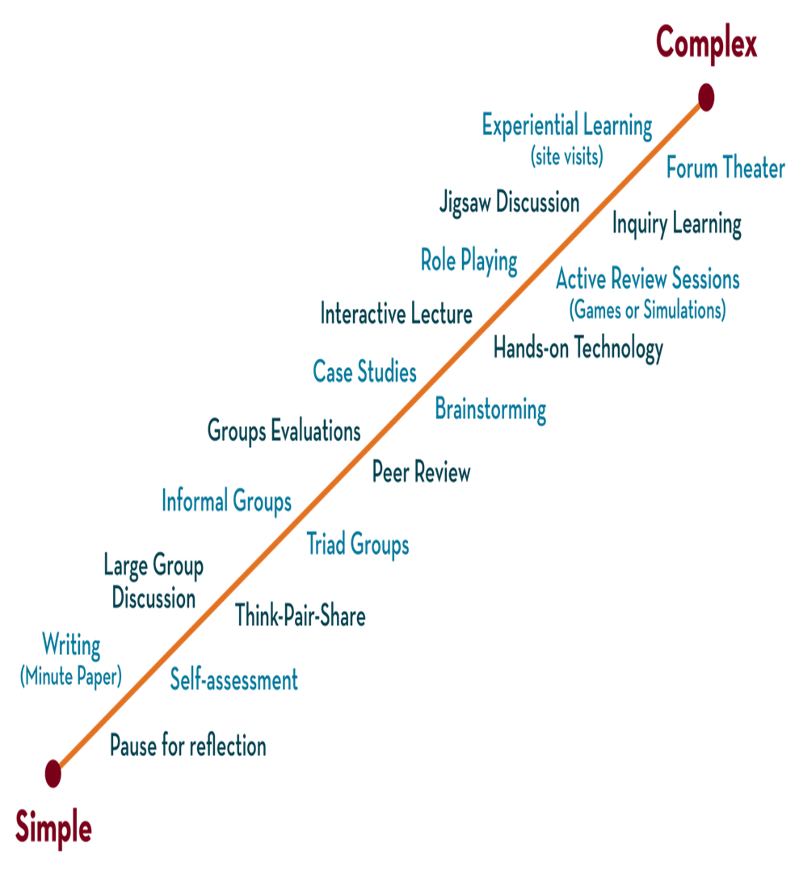

Department of CSE
DESIGN AND ANALYSIS OF ALGORITHMS
24CS2203
Topic:
Algorithm Basics
Session - 1

Slide 2





AIM OF THE SESSION
To familiarize students with the concept of Algorithm.
INSTRUCTIONAL OBJECTIVES
This Session is designed to:
Demonstrate :- What is an Algorithm.
Describe :- Steps to write an Algorithm.
LEARNING OUTCOMES
At the end of this session, you should be able to:
Define :- Algorithm.
Describe :- Areas for the study of Algorithm
Summarize:- How to write an algorithm.

Slide 3
Introduction
An algorithm is a finite set of instructions that can be used to perform a particular task.
In other words, an algorithm is a step-by-step procedure to solve a particular problem.
Here the problem is nothing but an expression of an algorithm containing a set of instructions.
The word algorithm comes from a Persian mathematician and scholar,
Muhammad ibn Musa al-Khwarizmi, who lived around 780–850 AD.
An algorithm is a set of rules for output calculations by hand or on a machine.

Slide 4
Properties
Input: it generally requires a finite number of inputs.
Output: it must produce at least one output.
Definiteness: each instruction must be clear and unambiguous (NO CONFUSION)
Finiteness: it must terminate after a finite number of steps.
Effectiveness: every step of an algorithm should be feasible. In other words, every step of the algorithm must be carried out manually.

Slide 5
Design steps
How to devise/ create an algorithm
How to analyze an algorithm
How to validate an algorithm
How to test an algorithm

Slide 6
Step - 1
How to devise/ create an algorithm
Creating an algorithm is an art that may never be fully automated.
Algorithmic design strategies help to create many useful algorithms.
Study of such type of design strategies is important in study of designing algorithms.

Slide 7
Step - 2
How to analyze an algorithm
Analysis of an algorithm is a task of determining how much time is required for computing and how much space will be required.
Analysis of an algorithm is also called performance analysis and these algorithms mainly concentrate on mathematics and logic.
The behavior of an algorithm in best case, average case, and worst case needs to be obtained.

Slide 8
Step - 3
How to validate an algorithm
The next step after the creation of an algorithm is to validate it.
The process of checking whether an algorithm computes the correct answer or not for all possible legal inputs is called algorithm validation.
The purpose of validation of an algorithm is to find whether it works properly or not independent of the programming language.

Slide 9
Step - 4
How to test an algorithm
Testing an algorithm can be broadly classified as
  Debugging: it is the process of identifying, analyzing, and removing errors or bugs from software or hardware systems to ensure they operate as intended.
  Profiling: it is a process of measuring the performance characteristics of an algorithm or a piece of software. This involves collecting data on various aspects such as execution time, memory usage, frequency and duration of function calls, and resource utilization. Profiling helps in identifying performance bottlenecks and areas for optimization.

Slide 10
Algorithm Specification
An algorithm is a sequence of instructions written in simple English or mathematical notations.
Other than algorithms, there are two more representations used by programmers
Flowchart – A visual representation of workflow/process.
Pseudo code - A high-level description of an algorithm that uses the structural conventions of programming languages but is designed for human reading rather than machine reading. It omits details that are specific to a particular programming language, focusing instead on the algorithm's logic and flow.

Slide 11
Pseudo-code
Pseudo-Code for writing Algorithms:
Comments begin with // and continue until the end of the line.
Blocks are indicated with matching braces { and }.
An identifier begins with a letter. The data types of variables are not explicitly declared.
Compound data types can be formed with records. Here is an example, Node.
Record
{
data type – 1
. . . . . . . . . .
. . . .
. . . . . data-1;
data type – n
data – n;
}

Slide 12
Pseudo-code
Assignment of values to variables is done using the assignment statement.
<Variable>:= <expression>;
Example: a:=10;
There are two Boolean values TRUE and FALSE.
Logical Operators
Relational Operators
AND, OR, NOT
<, <=,>,>=, =, !=
7. The following looping statements are employed.
For, while and repeat-until
while loop:
while < condition > do {
<statement-1>
…
<statement-n>
}

Slide 13
Pseudo-code
For Loop:
for variable: = value-1 to value-2 step step do
{
<statement-1>
.
.
<statement-n>
}
One step is a key word, other Step is used for increment or decrement

Slide 14
Pseudo-code
repeat-until:
repeat{
<statement-1>
.
.
<statement-n>
} until<condition>

Slide 15
Pseudo-code
A conditional statement has the following forms.
  if <condition> then <statement>
  if <condition> then <statement-1>
else <statement-2>
Case statement:
case
  {
  :<condition-1>:<statement-1>
  .
  .
  :<condition-n>:<statement-n>
  :else:<statement-n+1>
  }

Slide 16
Pseudo-code
Input and output are done using the instructions read & write.
There is only one type of procedure:
Algorithm, the heading takes the form, Algorithm Name (<Parameter list>)

Slide 17
Do’s and Don’ts
Do’s:
Use control structures
Use proper naming convention
Indentation and white spacing are the key
Keep it simple
Keep it concise.
Don’ts
Don’t make pseudo code abstract
Don’t be too generalized.

Slide 18
Pseudo-code
Example
Function Max(A,n)
// a is an array of size n
{
result := a[1];
for i:= 2 to n do
if a[i] > result then
result :=a[i];
return result;
}
Write Psuedo Code for binary search algorithm

Slide 19
Pseudo-code
What will be the output of the following pseudocode?
Question 1) for i=0 to 4 step 1 do
If i==i++ + --i then do
display i
end-if
end-for
Question 2) Set Character c = '7'
switch(c)
case '1': display "One"
case '7': display "Seven"
case '2': display "Two"
default: display "Hello"
break
end-switch

Slide 20
SUMMARY
An algorithm is a finite set of instructions that can be used to perform a particular task.
In other words, an algorithm is a step-by-step procedure to solve a particular problem.

Slide 21


SELF-ASSESSMENT QUESTIONS
What is an algorithm?
A programming language
A step-by-step procedure for solving a problem or accomplishing a task
A type of computer hardware
A data structure
Which notation is commonly used for algorithm specification to describe the sequence of operations?
UML diagrams
Pseudocode
Binary code
Machine language

Slide 22
TERMINAL QUESTIONS
Write an algorithm for calculating the factorial of a number?
write an algorithm to check if a given string is a palindrome

Slide 23
REFERENCES FOR FURTHER LEARNING OF THE SESSION
Text Books :
1. Ellis Horowitz, Sartaj Sahni and Sanguthevar Rajasekaran, “Fundamentals of ComputerAlgorithms”, 2nd Edition, University Press, 2008.
2. Cormen, Leizerson &Rivest, “Introduction toalgorithms”, 3rd Edition, Prentice-Hall, 2002.
3. Jon Kleinberg and Eva Tardos, “Algorithm Design”,Pearson Education, 2006.
Reference Books :
1. Robert Sedgewick and Kevin wayne , “Algorithms”, 4th edition, Addison WesleyProf.,(2011).
2. Anny Levitin, “Introduction to Design and Analysis of Algorithms”, 2rd Edition, PersonEducation Press. (2007).
3. Michael T.Goodrich and Roberto Tamassia, Algorithm Design: Foundations,Analysis and Internet Examples, Second Edition, Wiley-India, (2006).
4. Steven S. Skiena, “The AlgorithmDesign Manual”, Second Edition, Springer, (2008)
MOOCS :
1. https://www.coursera.org/specializations/algorithms?= 2.https://www.coursera.org/learn/dynamic-programming-greedy-algorithms#modules

Slide 24
THANK YOU

